Slide 1


Time Period 57 of 76
predicts the stock will go up

Slide 2

Time Period 57 of 76
predicts the stock will go up

Slide 3

Time Period 57 of 76
predicts the stock will go up

Slide 4

Time Period 57 of 76
predicts the stock will go up

Slide 5

Time Period 57 of 76
predicts the stock will go up

Slide 6

Time Period 57 of 76
predicts the stock will go up

Slide 7
Time Period 57 of 76
UP
DOWN

Slide 8

The stock went up!

Slide 9
You guessed correctly!
+10 cents

Slide 10
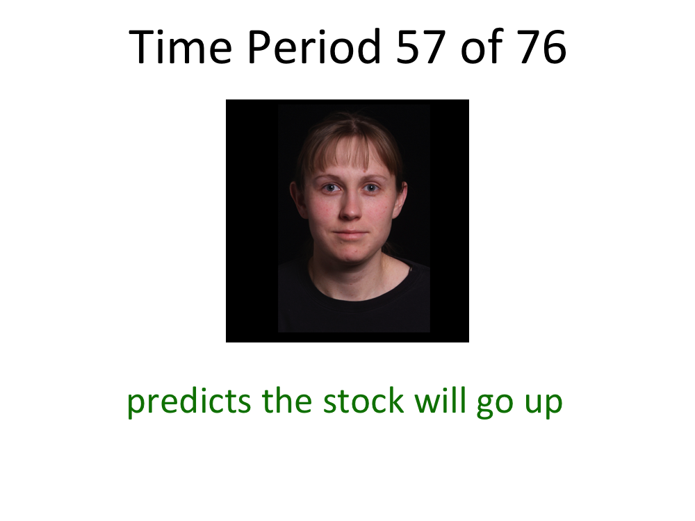
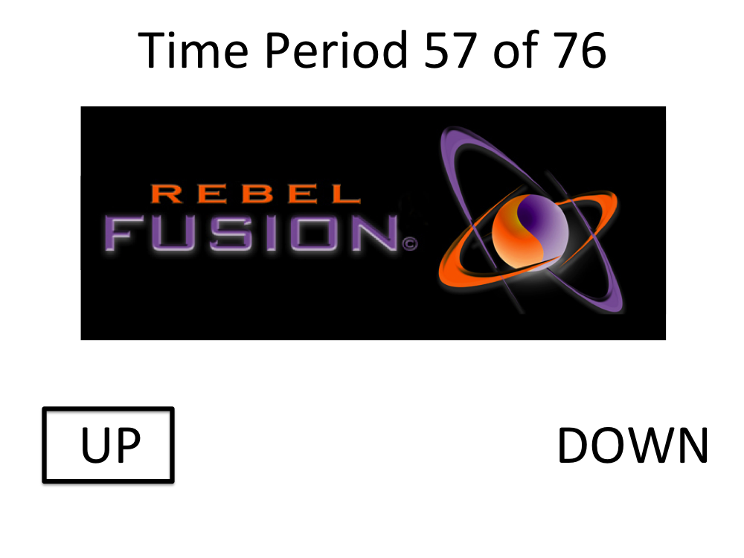
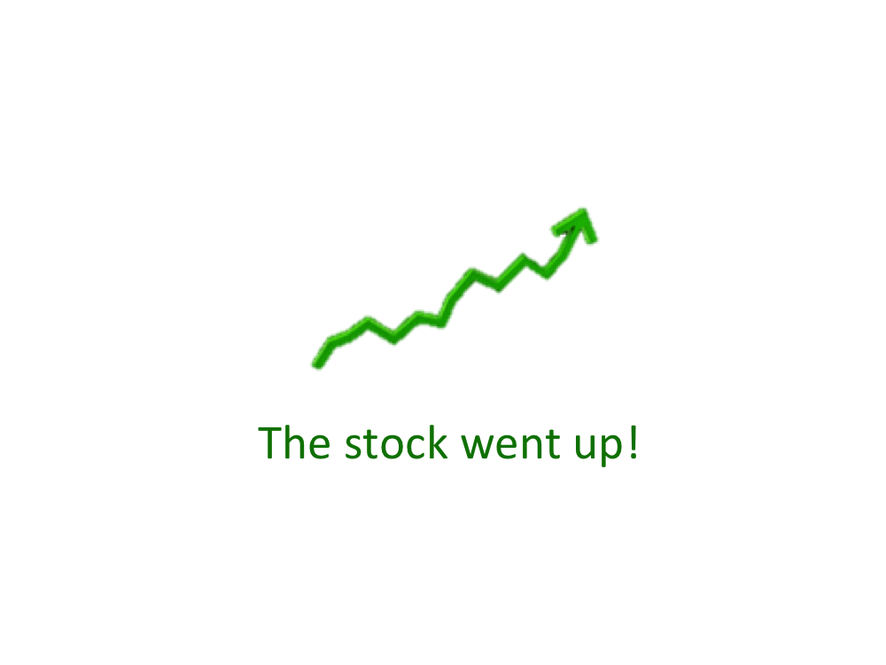
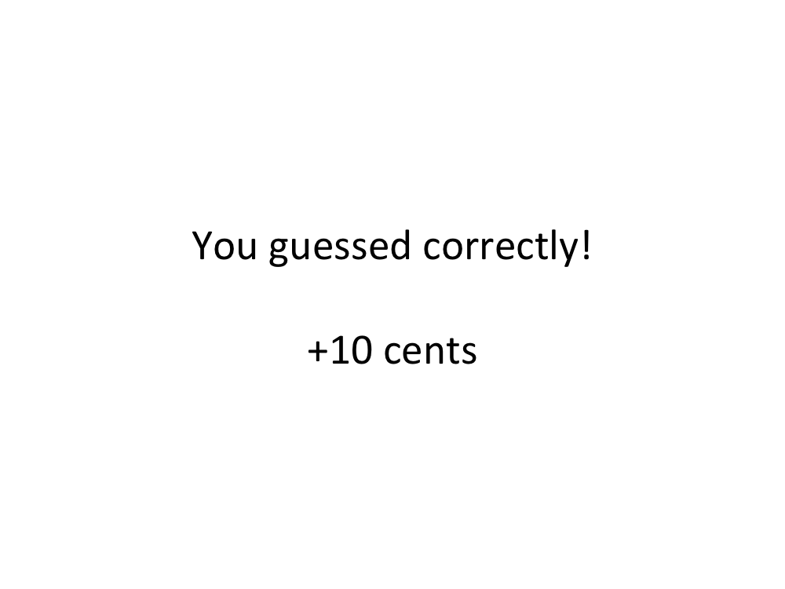
Donna’s
Recommendation
Predict Stock
Stock Performance
Were you correct?
…

Slide 11
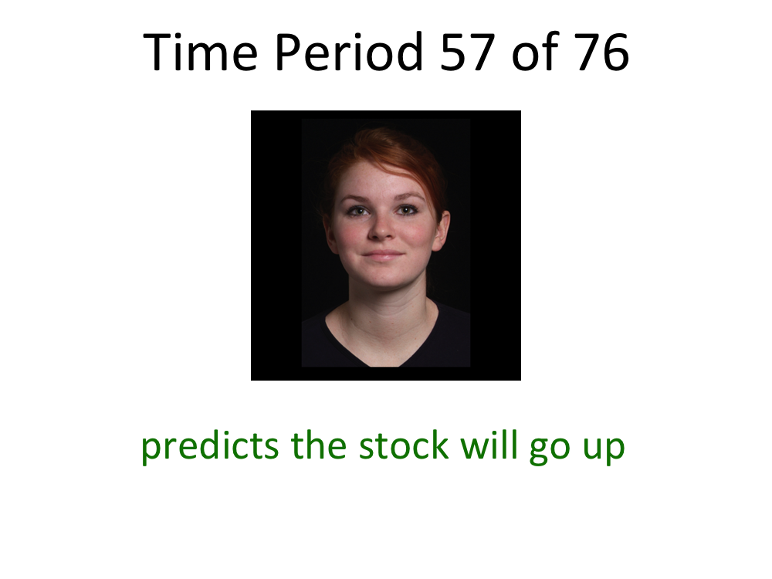
Donna’s
Recommendation
Predict Stock
Stock Performance
Were you correct?
…

Slide 12
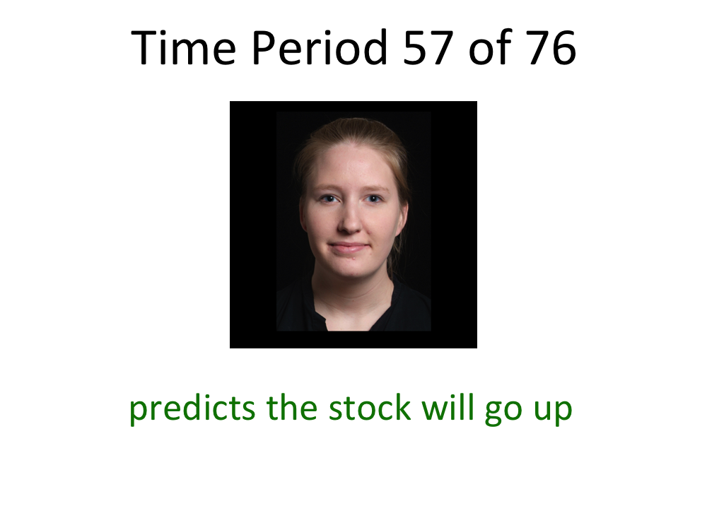
Donna’s
Recommendation
Predict Stock
Stock Performance
Were you correct?
…

Slide 13
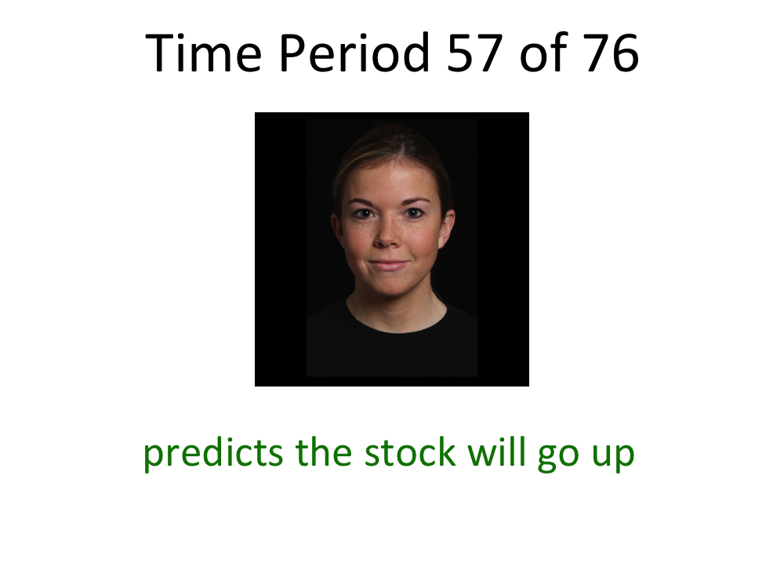
Donna’s
Recommendation
Predict Stock
Stock Performance
Were you correct?
…

Slide 14
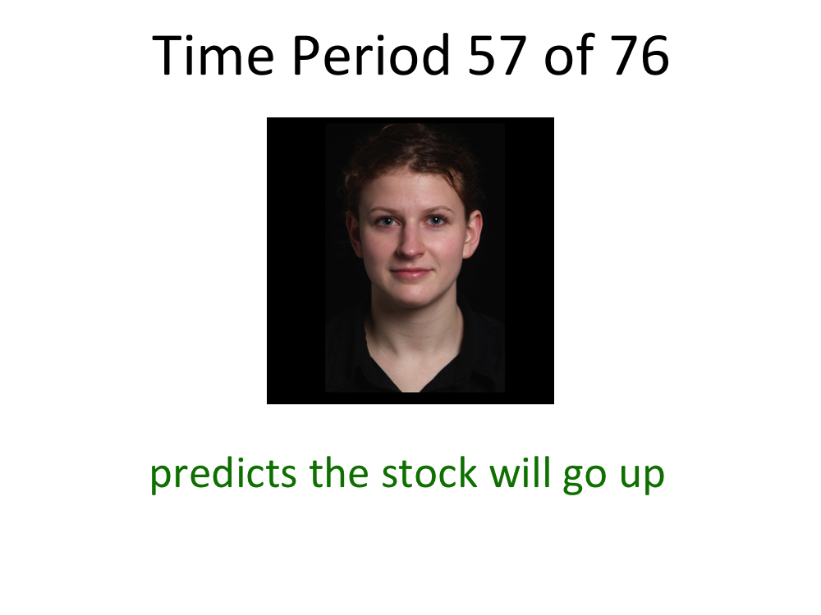
Donna’s
Recommendation
Predict Stock
Stock Performance
Were you correct?
…

Slide 15
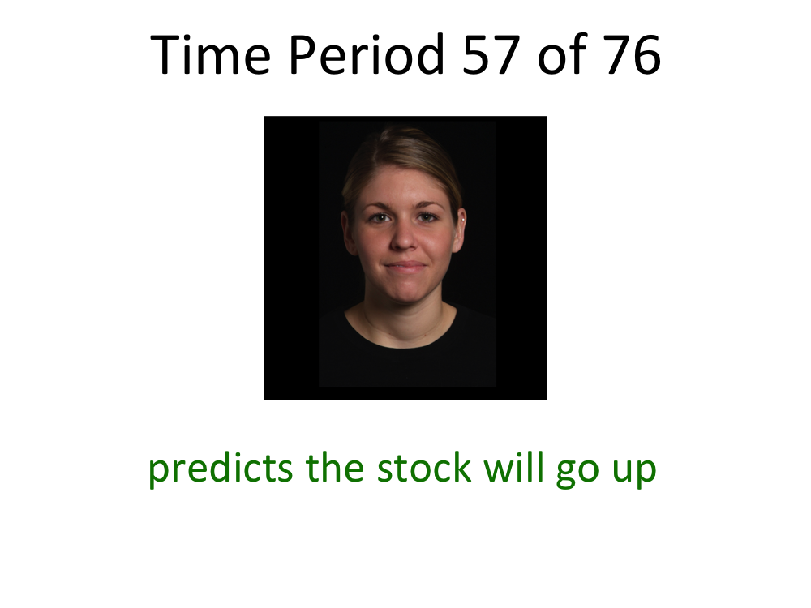
Donna’s
Recommendation
Predict Stock
Stock Performance
Were you correct?
…

